Slide 1
work report (ojt)
RDB S21
MAO Zhengjun(毛正军)
2018/3/12

Slide 2
Catalog
Introduce
Schedule
Work Report
Harvest
Plan And Goals

Slide 3

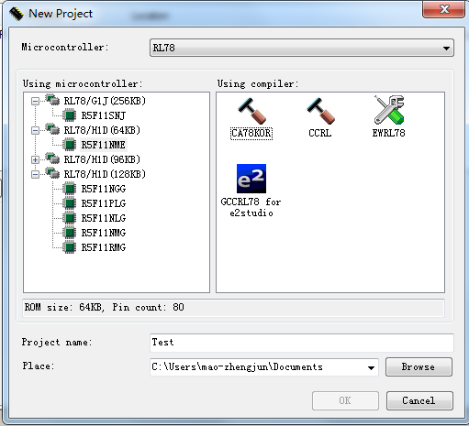
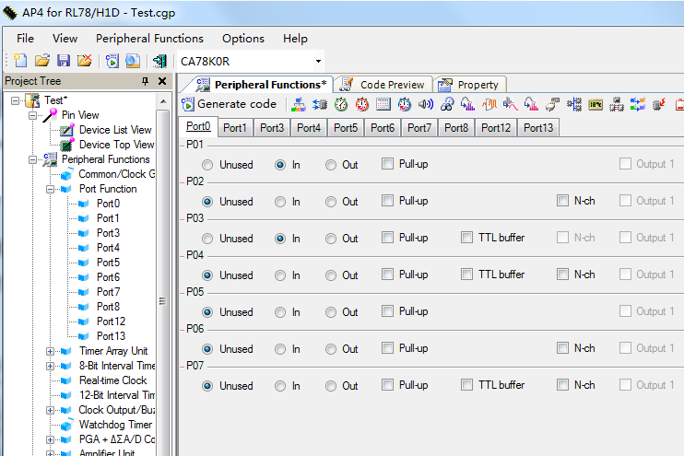
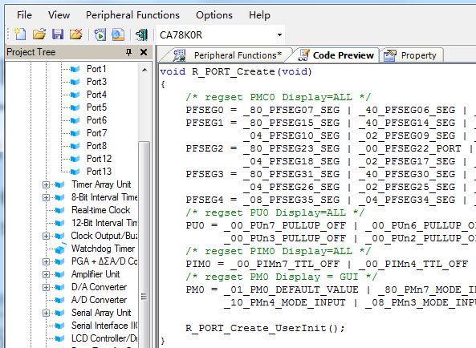
Introduction
What is the Code Generator
Code Generator is a software for generating driver code automatically by simple and convenient graphical interface configuration
How to use it
Select device
Configure peripherals
Generate driver code

Slide 4










Introduction
Supports different devices
(Renesas, GHS, IAR, GNU, GCC)
Supports different compilers
Supports different integrated environment

Slide 5
Catalog
Introduce
Schedule
Work Report
Harvest
Plan And Goals

Slide 6
Schedule
2017 |  |  |  |  |  | 2018
July | Aug | Sept | Oct | Nov | Dec | Jan | Feb | Mar
RL78H1D development
RL78G1J development
Maintenance
No. | Peripherals
1 | CGC
2 | TAU
3 | 8BITIT
4 | RTC
5 | 12BITIT
6 | TMRJ
7 | SMOTD
8 | EXSD
9 | PCLBUZ
10 | WDT
11 | PGA_DSAD
12 | AMP
13 | DA
14 | AD
15 | IICA
16 | UARTMG
… | …
No. | Peripherals
1 | CGC
2 | WDT
3 | CMP
4 | AD
5 | DA
6 | PORT
7 | TAU
8 | RTC
9 | 12BITIT
10 | TMRJ
11 | TMRD
12 | TMRG
13 | PCLBUZ
14 | SAU
15 | RF
16 | IICA
… | …
No. | Ticket
1 | #2446
2 | IDE17308
3 | #1897
4 | #2429
5 | IDE18629
6 | IDE17833
… | …
My tasks

Slide 7
Catalog
Introduce
Schedule
Work Report
Harvest
Plan And Goals

Slide 8
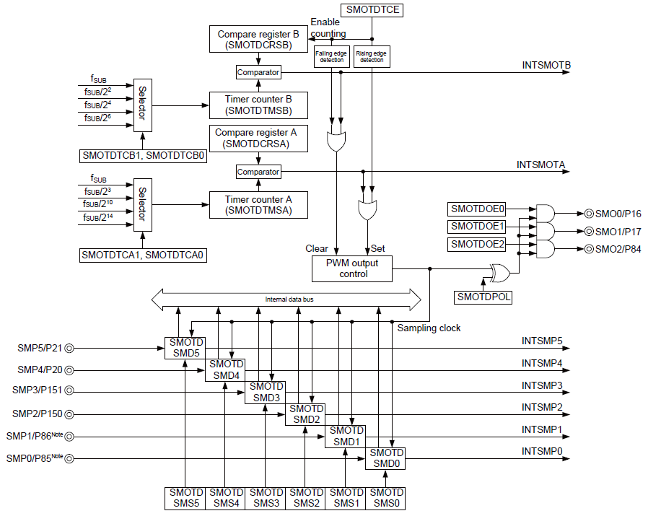
WORK-Achievements
Manual learning
Detailed design
Coding
Test
Block diagram of peripherals

Slide 9
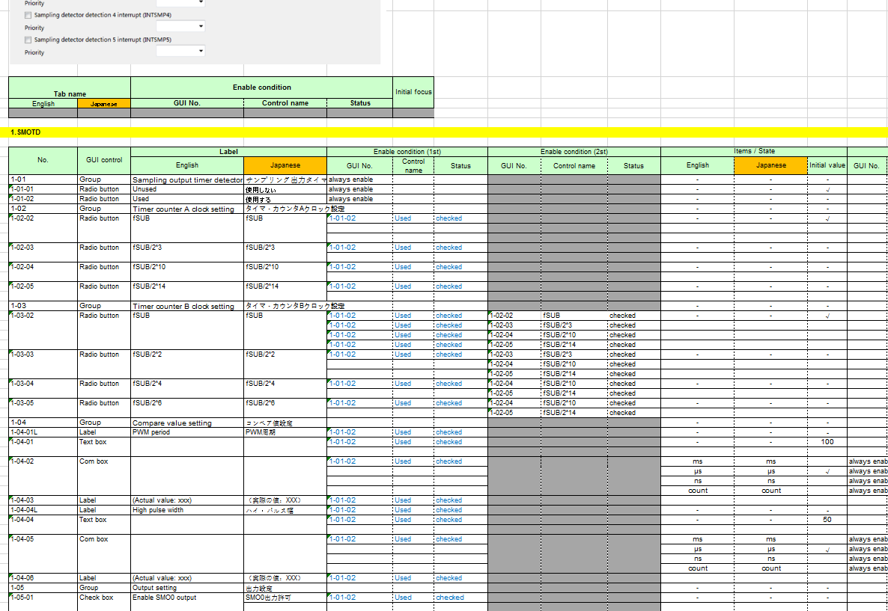
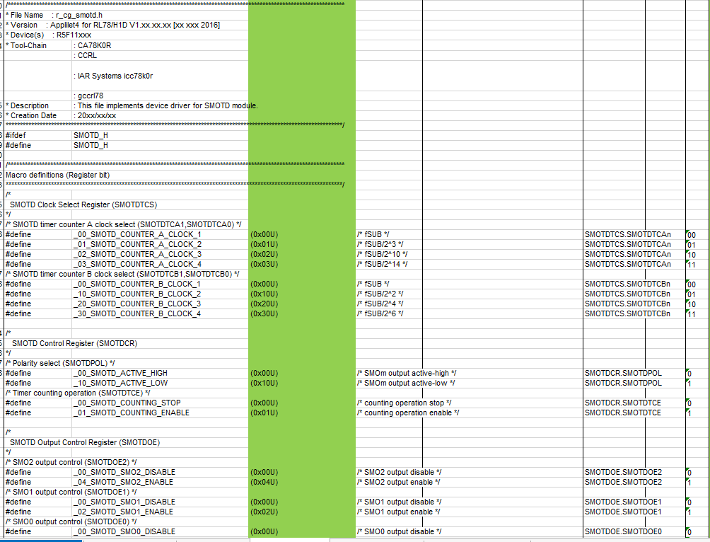
WORKS-Achievements
Manual learning
Detailed design
Coding
Test
GUI detailed design
Task | Achievements | Object size
RL78H1D | DetailedDesign_8BITIT_(RL78H1D).xlsx | 5 sheet
 | DetailedDesign_SMOTD_(RL78H1D).xlsx | 6 sheet
 | DetailedDesign_PAG_DSAD_(RL78H1D).xlsx | 6 sheet
 | DetailedDesign_WDT_(RL78H1D).xlsx | 5 sheet
RL78G1J | DetailedDesign_WDT_(RL78G1J).xlsx | 5 sheet
 | DetailedDesign_CMP_(RL78G1J).xlsx | 6 sheet
 | DetailedDesign_AD_(RL78G1J).xlsx | 6 sheet
 | DetailedDesign_DA_(RL78G1J).xlsx | 6 sheet
Code detailed design

Slide 10
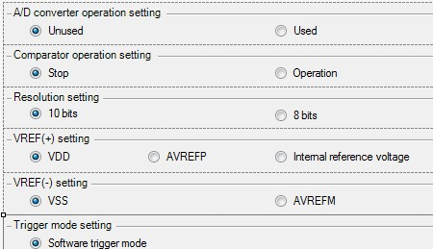
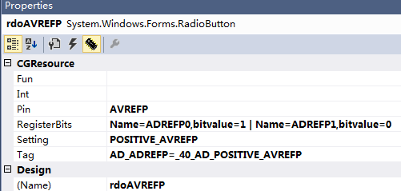
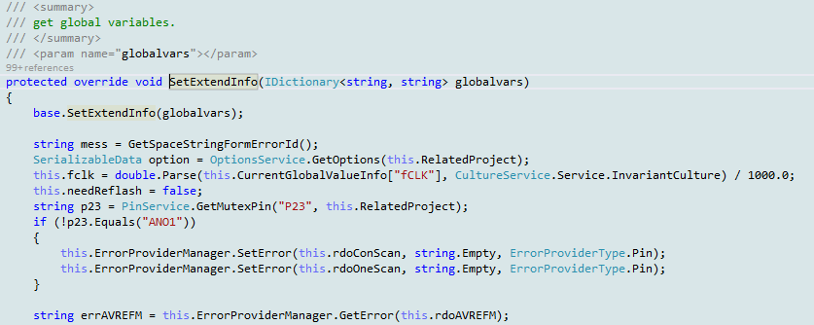
WORKS-Achievements
Manual learning
Detailed design
Coding
Test
Bind pin setting to buttons by visual programming tool.
Business logic code

Slide 11
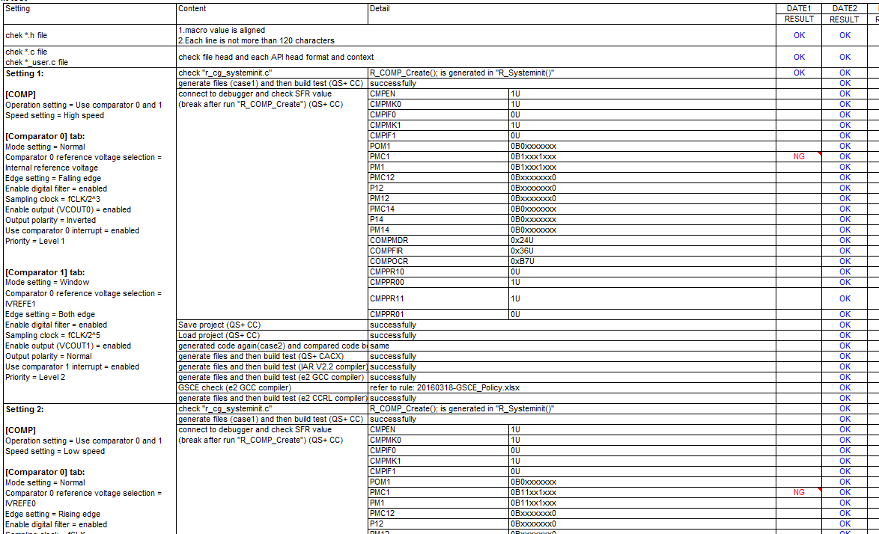
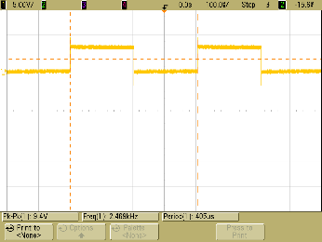
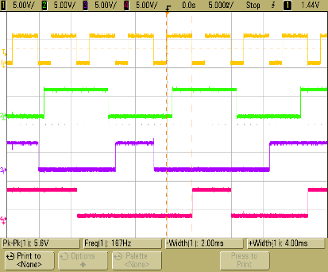
WORKS-Achievements
Manual learning
Detailed design
Coding
Test
Test results
Hardware test
Task | Achievements | Object size
RL78H1D | TestSpec&Report_8BITIT_(RL78H1D).xlsx | 7 sheet
 | TestSpec&Report_SMOTD_(RL78H1D).xlsx | 7 sheet
 | TestSpec&Report_PAG_DSAD_(RL78H1D).xlsx | 7 sheet
 | TestSpec&Report_WDT_(RL78H1D).xlsx | 7 sheet
RL78G1J | TestSpec&Report_WDT_(RL78G1J).xlsx | 7 sheet
 | TestSpec&Report_CMP_(RL78G1J).xlsx | 7 sheet
 | TestSpec&Report_AD_(RL78G1J).xlsx | 7 sheet
 | TestSpec&Report_DA_(RL78G1J).xlsx | 7 sheet

Slide 12
Catalog
Introduce
Schedule
Work Report
Harvest
Plan And Goals

Slide 13

harvest
▬▬▬▬ Technique Skills
Learned how to build CG development environment
Be familiar with development process
Learn principle of peripheral
Have a certain understanding of CG framework
Learned how to used oscilloscope, multimeter and other tools
Have a certain understanding of modular programming

Slide 14

harvest
▬▬▬▬ Other aspects
Teamwork is very important
Stand on the customer’s point to consider

Slide 15
Catalog
Introduce
Schedule
Work Report
Harvest
Plan And Goals

Slide 16

plan and goals
Working ability
Complete tasks on schedule with good quality.
Improve work efficiency.
MCU Peripherals
Improve the ability to handle complex modules.
Such as : Timer Array Unit, Serial Array Unit
Software development
Learn plug-in development technology for eclipse

Slide 17
Thank you for your time today!

Slide 18
Renesas.com

Slide 19
Q&A

